Slide 1
Proposed Updates to the Framework for Improving Critical Infrastructure Cybersecurity (Draft Version 1.1)
March 2017
cyberframework@nist.gov

Slide 2
Charter for Continued Development and Evolution
Amends the National Institute of Standards and Technology Act to say:
“…on an ongoing basis, facilitate and support the development of a voluntary, consensus-based, industry-led set of standards, guidelines, best practices, methodologies, procedures, and processes to cost-effectively reduce cyber risks to critical infrastructure”
Cybersecurity Enhancement Act of 2014
18 December 2014

Slide 3
Input to the Proposed Framework Update Draft Cybersecurity Framework Version 1.1
The Update was based on feedback from the cybersecurity community including:
December 2015 request for information
April 2016 Cybersecurity Framework workshop
Lessons learned from Framework use
Shared resources from industry partners
Advances made in areas identified in the Roadmap issued with the Framework in February 2014

Slide 4
Compatibility Draft Cybersecurity Framework Version 1.1
Draft Version 1.1 of the Cybersecurity Framework seeks to clarify, refine, and enhance the Framework
Industry feedback through workshops and RFIs has made it clear that change should be minimal and that the Framework must remain compatible with v1.0
CHANGES… 0
DELETIONS… 0
FULLY BACKWARDS COMPATIBLE!
Additions including new categories and subcategories do not invalidate existing v1.0 work products

Slide 5
Proposed Core Updates Draft Cybersecurity Framework Version 1.1
Component | Version 1.0 | Version 1.1 | Comments
Functions | 5 | 5 | No modification
Categories | 22 | 23 | Added a new category in ID.SC – Supply Chain Expanded PR.AC to include identity management, authentication, and identity proofing
Subcategories | 98 | 106 | Added 5 Subcategories in ID.SC Added 1 subcategory in PR.DS Added 1 subcategory in PR.AC Added 1 subcategory in PR.PT Clarified language in 7 others
Informative References | 5 | 5 | No modification

Slide 6
Major Themes from Inputs
Draft Cybersecurity Framework Version 1.1
Several major themes were identified and considered during the update which included:
Strengthening authentication & identity management in the Framework Core
Guidance for acquisition and supply chain risk management (SCRM)
Methodology for measurement and generating metrics
Clarity on Implementation Tiers and their relationship to Profiles

Slide 7
Communicating Cybersecurity Requirements with Stakeholders
A primary objective of cyber SCRM is to identify, assess, and mitigate products and services that may contain potentially malicious functionality, are counterfeit, or are vulnerable due to poor manufacturing and development practices within the cyber supply chain
Determining cybersecurity requirements for suppliers and information technology (IT) and operational technology (OT) partners
Enacting cybersecurity requirements through formal agreement (e.g. contracts)
Communicating to suppliers and partners how those cybersecurity requirements will be verified and validated
Verifying cybersecurity requirements are met through a variety of assessment methodologies
Governing and managing the above activities

Slide 8
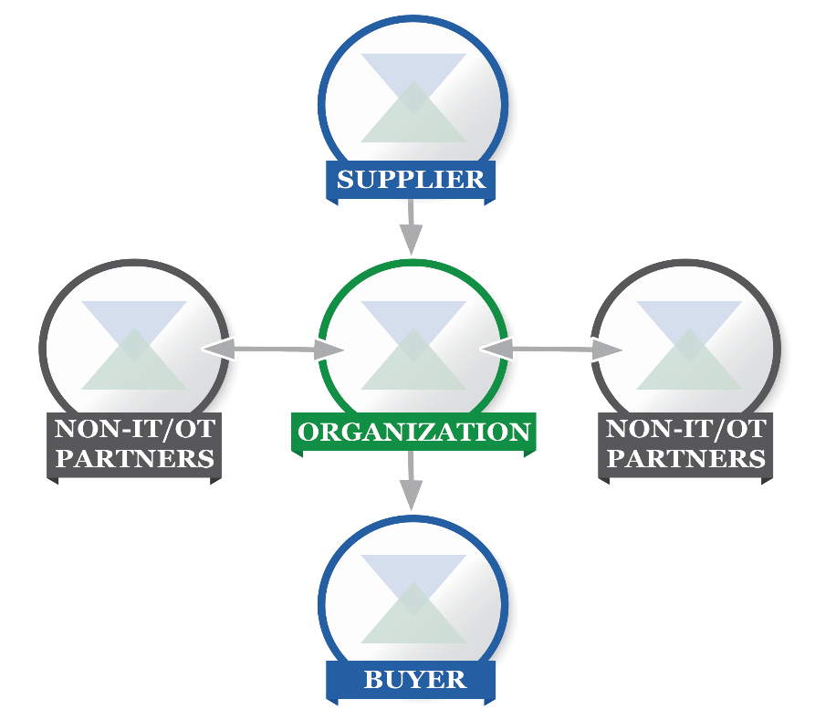
Cyber SCRM Taxonomy Draft Cybersecurity Framework Version 1.1
Cyber SCRM in the Framework compliments SP800-161
Graphic represents taxonomy of supply chain entities
Cyber SCRM encompasses IT and OT suppliers and buyers as well as non-IT and OT partners
Stakeholders should be identified and factored into the protective, detective, response, and recovery capabilities

Slide 9
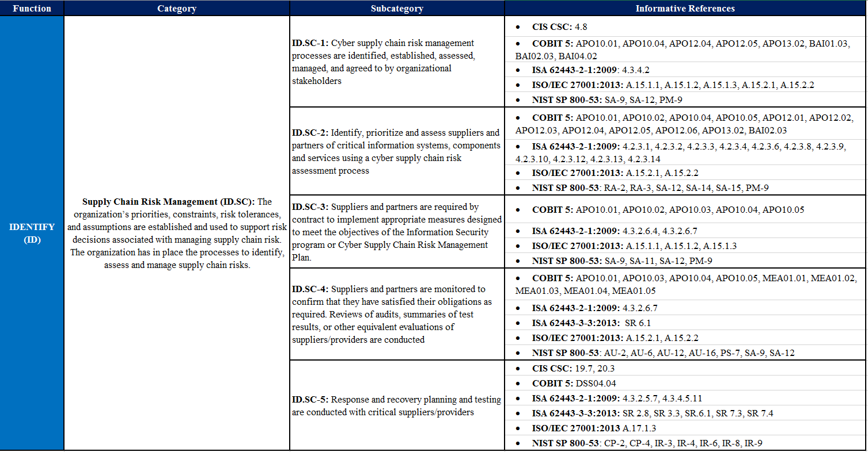
Cyber SCRM Additions to the Core Draft Cybersecurity Framework Version 1.1

Slide 10
Cyber SCRM in Framework Implementation Tiers Draft Cybersecurity Framework Version 1.1
Tier | New Text
1 | An organization may not understand the full implications of cyber supply chain risks or have the processes in place to identify, assess and mitigate its cyber supply chain risks.
2 | The organization understands the cyber supply chain risks associated with the products and services that either supports the business mission function of the organization or that are utilized in the organization’s products or services. The organization has not formalized its capabilities to manage cyber supply chain risks internally or with its suppliers and partners and performs these activities inconsistently.
3 | An organization-wide approach to managing cyber supply chain risks is enacted via enterprise risk management policies, processes and procedures. This likely includes a governance structure (e.g. Risk Council) that manages cyber supply chain risks in balance with other enterprise risks. Policies, processes, and procedures are implemented consistently, as intended, and continuously monitored and reviewed. Personnel possess the knowledge and skills to perform their appointed cyber supply chain risk management responsibilities. The organization has formal agreements in place to communicate baseline requirements to its suppliers and partners.
4 | The organization can quickly and efficiently account for emerging cyber supply chain risks using real-time or near real-time information and leveraging an institutionalized knowledge of cyber supply chain risk management with its external suppliers and partners as well as internally, in related functional areas and at all levels of the organization. The organization communicates proactively and uses formal (e.g. agreements) and informal mechanisms to develop and maintain strong relationships with its suppliers, partners, and individual and organizational buyers.

Slide 11
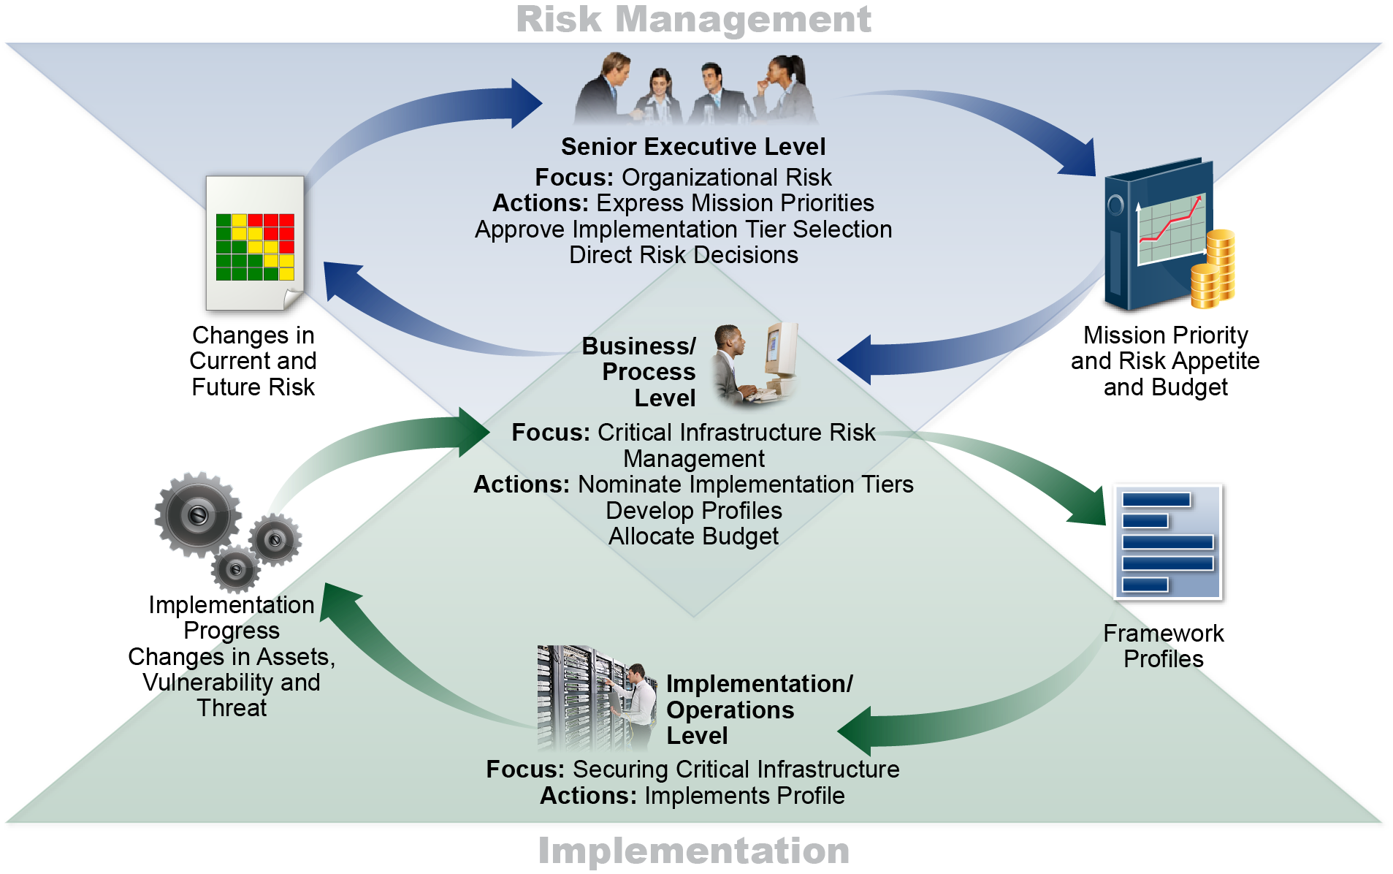
Implementation Tiers and Profiles Draft Cybersecurity Framework Version 1.1
• Additional language added on use of Framework Tiers to include prioritization within target Profile and to inform progress in addressing Profile gaps
• Language added to reflect integration of Framework considerations within organizational risk management programs
• Tiers have been expanded to include cyber SCRM considerations
• Figure 2.0 updated to include actions from the Framework Tiers

Slide 12
Tiers Included in the Framework 7-Step Process Draft Cybersecurity Framework Version 1.1
Step 1: Prioritize and Scope
Implementation Tiers may be used to express varying risk tolerances
Step 2: Orient
Step 3: Create a Current Profile
Step 4: Conduct a Risk Assessment
Step 5: Create a Target Profile
When used in conjunction with an Implementation Tier, characteristics of the Tier level should be reflected in the desired cybersecurity outcomes
Step 6: Determine, Analyze, and Prioritize Gaps
Step 7: Implementation Action Plan

Slide 13
Integrated Risk Management in Implementation Tiers Draft Cybersecurity Framework Version 1.1
Tier | New Text
1 | No Modification
2 | Consideration of cybersecurity in mission/business objectives may occur at some levels of the organization, but not at all levels. Cyber risk assessment of organizational assets is not typically repeatable or reoccurring.
3 | The organization consistently and accurately monitors cybersecurity risk of organizational assets. Senior cybersecurity and non-cybersecurity executives communicate regularly regarding cybersecurity risk. Senior executives ensure consideration of cybersecurity through all lines of operation in the organization.
4 | The relationship between cybersecurity risk and mission/business objectives is clearly understood and considered when making decisions. Senior executives monitor cybersecurity risk in the same context as financial risk and other organizational risks. The organizational budget is based on understanding of current and predicted risk environment and future risk appetites. Business units implement executive vision and analyze system level risks in the context of the organizational risk appetite and tolerances. Cybersecurity risk is clearly articulated and understood across all strata of the enterprise. The organization can quickly and efficiently account for changes to business/mission objectives and threat and technology landscapes in how risk is communicated and approached.

Slide 14
Identity Management Draft Cybersecurity Framework Version 1.1
Language of the Access Control category refined to better account for authentication, authorization, and identity proofing
Subcategory on identity proofing (PR.AC-6) added to the Access Control category
Access Control category renamed to “Identity Management, Authentication, and Access Control” (PR.AC) to better represent Category and Subcategories scope

Slide 15
Cybersecurity Measurement
Draft Cybersecurity Framework Version 1.1
Sections 4.0 and 4.1
Correlation between business results and cybersecurity risk management outcomes
Metrics versus measures
Leading versus lagging
Section 4.2
Types of Cybersecurity Measurement
Framework measurement provides a basis for strong, trusted relationships, both inside and outside of an organization
 | Behaviors | Outcomes
Higher-Level | Implementation Tiers | Core
Lower-Level | Process | Informative References
 | Behaviors | Outcomes
“Metrics” | ”Practices” | ”Management”
“Measures” | “Process” | “Technical”

Slide 16
Feedback Appreciated! Draft Cybersecurity Framework Version 1.1
90-day public comment period ends April 10, 2017
Spring 2017 workshop scheduled for May 16th and 17th to encourage additional feedback on Framework draft Version 1.1 and on V1.0 experience, including:
○ Use cases
○ Best Practice sharing
○ The Framework’s further development
18

Slide 17
Resources Where to Learn More and Stay Current
Framework for Improving Critical Infrastructure Cybersecurity and related news, information:
www.nist.gov/cyberframework
Additional cybersecurity resources:
http://csrc.nist.gov/
Questions, comments, ideas:
cyberframework@nist.gov
19

